Slide 1

Why dogs make the best programmers
Hannah Ellicott

Slide 2
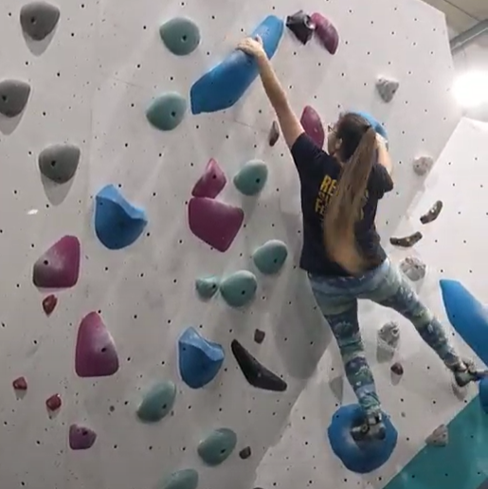
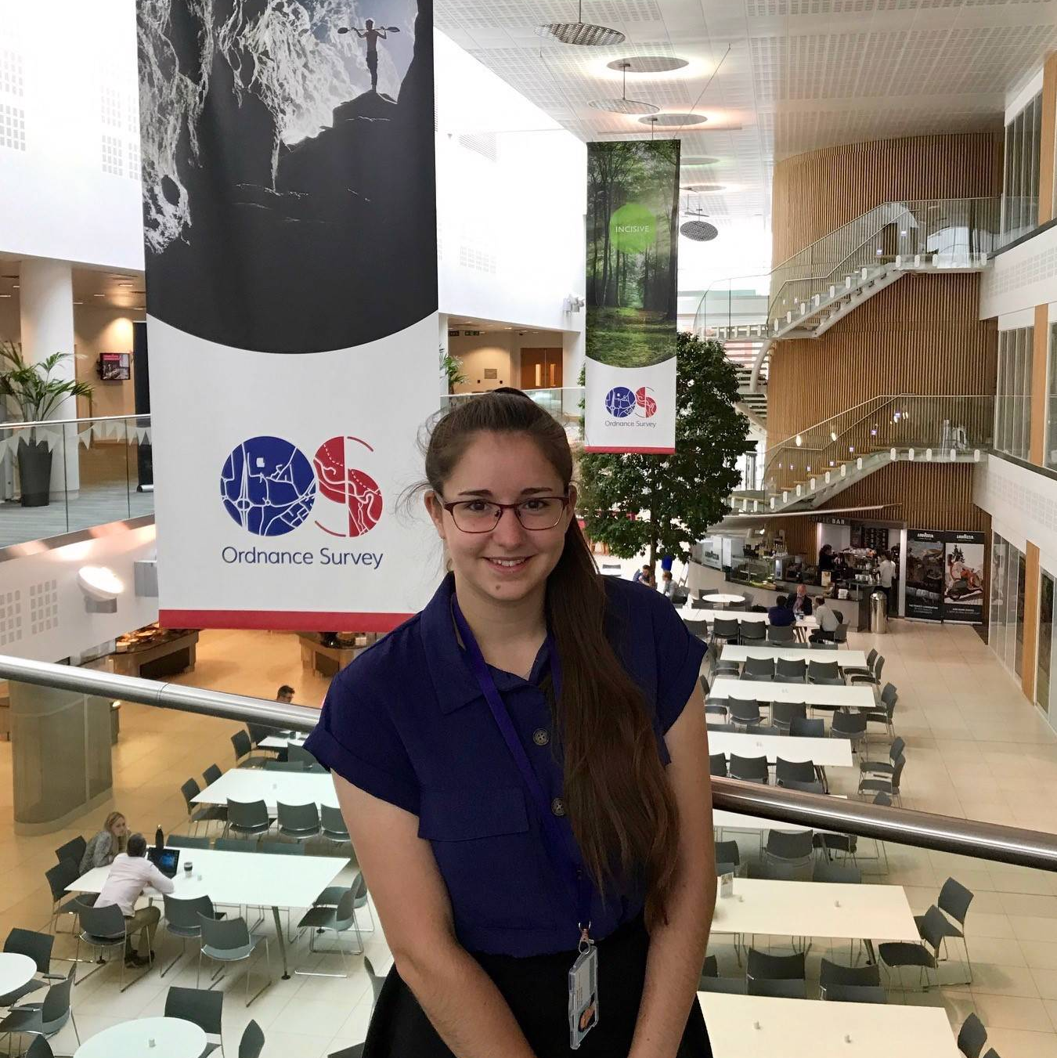
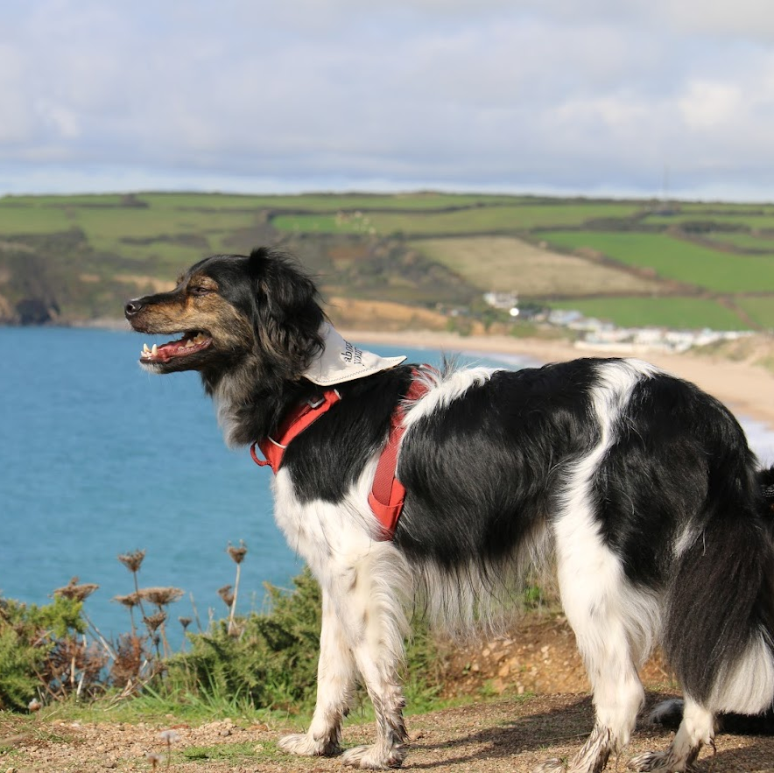
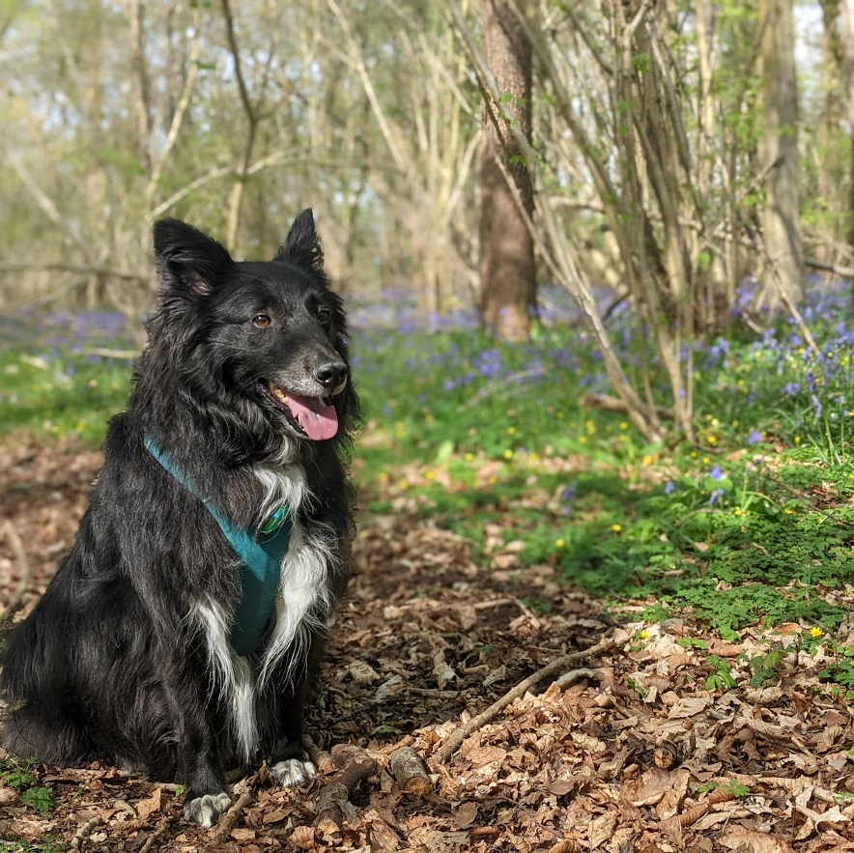
Hannah Ellicott
Software Engineer
Climbing Instructor
Dog lover

Slide 3


Agenda
How are dogs and programming connected?
Code Smells
Dispensables
Bloaters
Couplers
10 mins
Q&A
5 mins

Slide 4
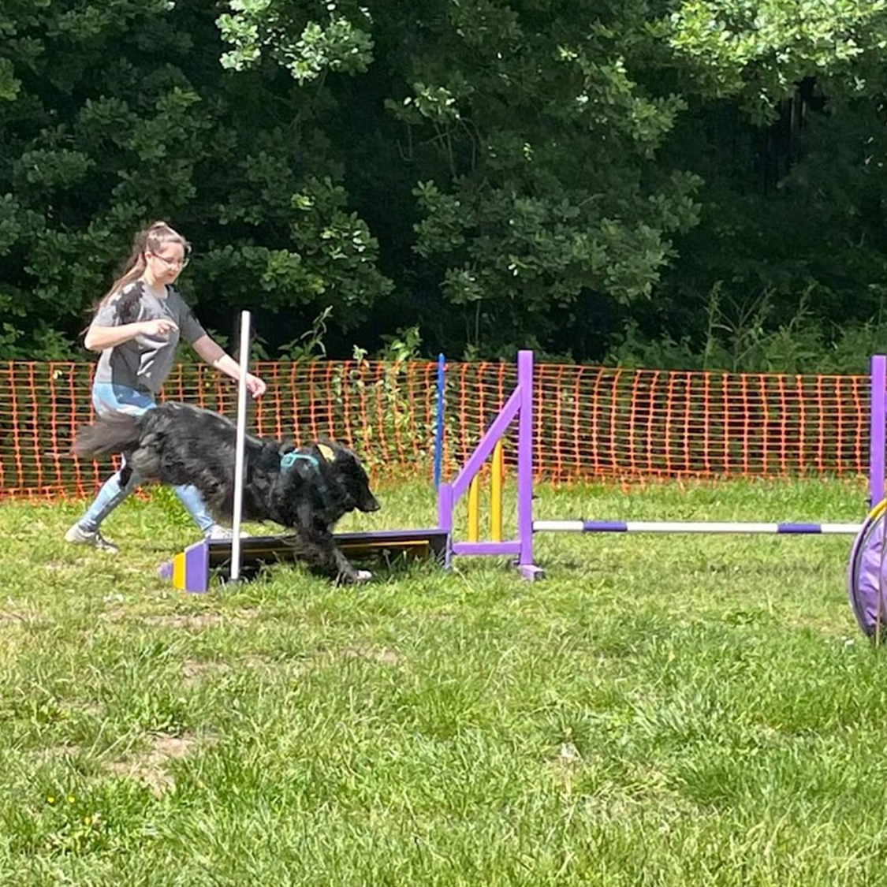
How are dogs and programming connected?
Training
Patience
Time
Problem Solving
Maintenance

Slide 5
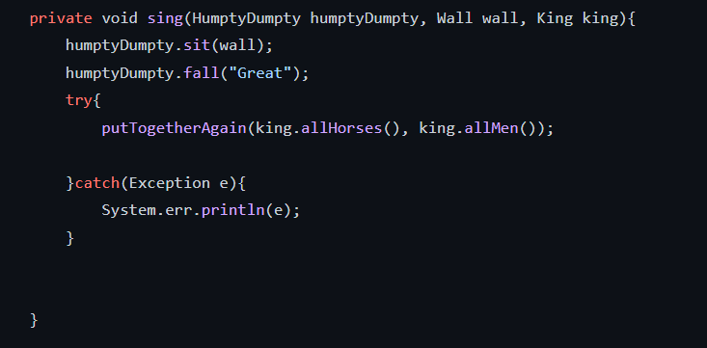
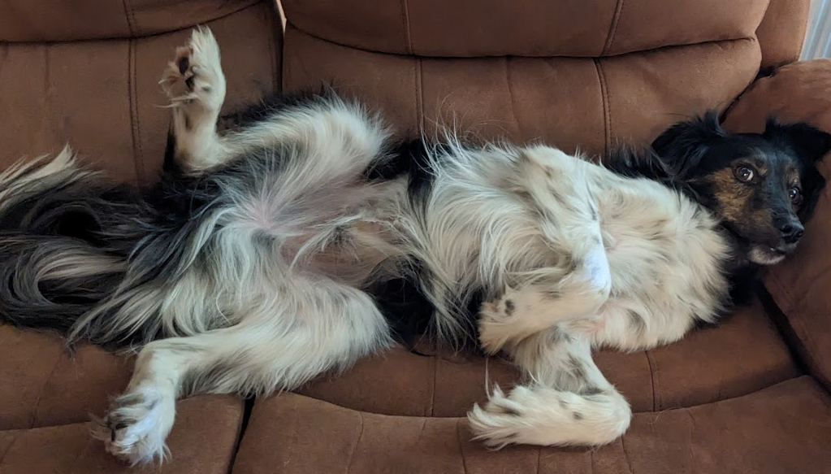
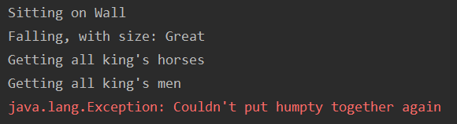
Communicating Intent
Clear
Concise
Consistent
Full Code: https://github.com/hellicott/codemanship#humpty-dumpty

Slide 6
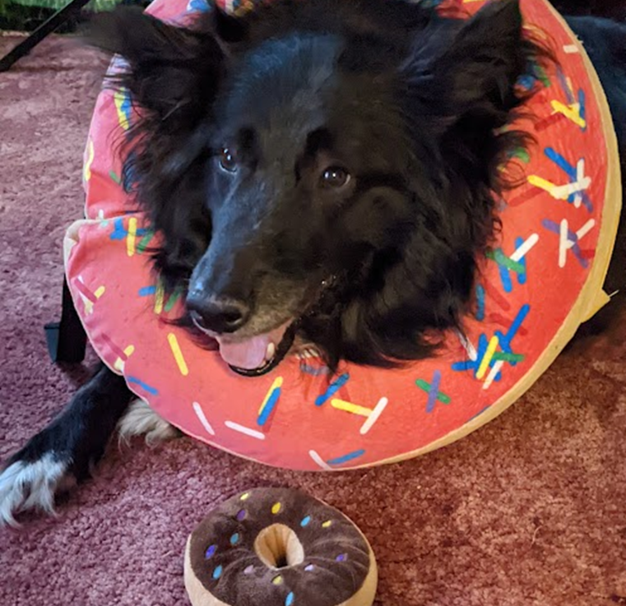
Code Smells

Slide 7
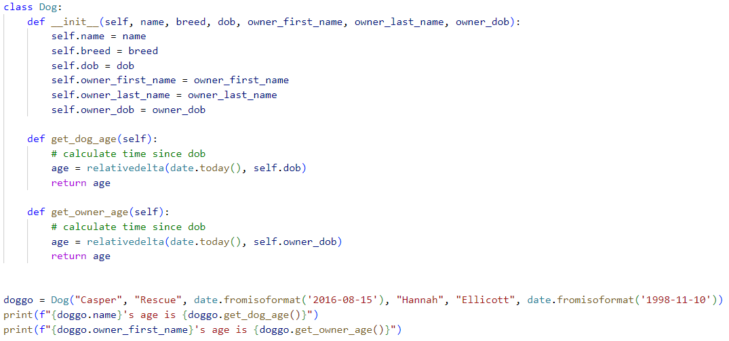

Slide 8
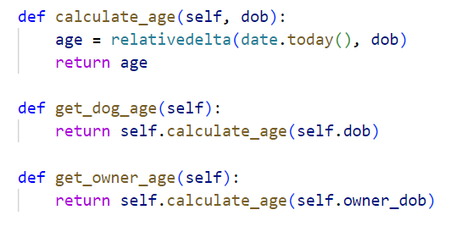
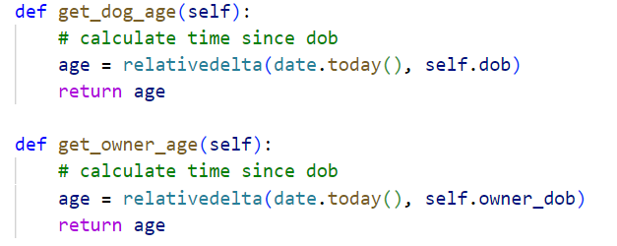
Dispensables
Comments
Duplicates
Unused Code

Slide 9
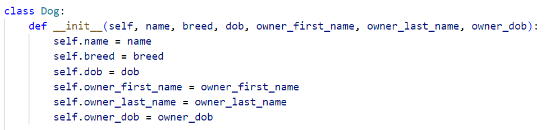
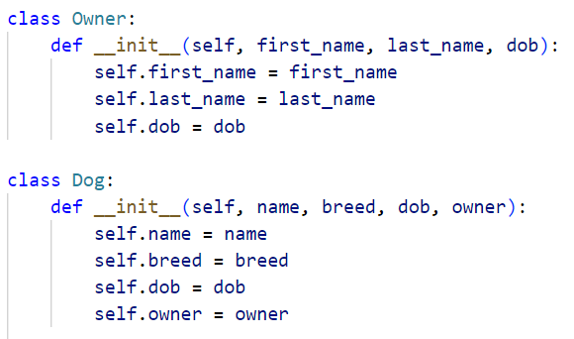

Bloaters
Many parameters
Long methods
Primitive types

Slide 10
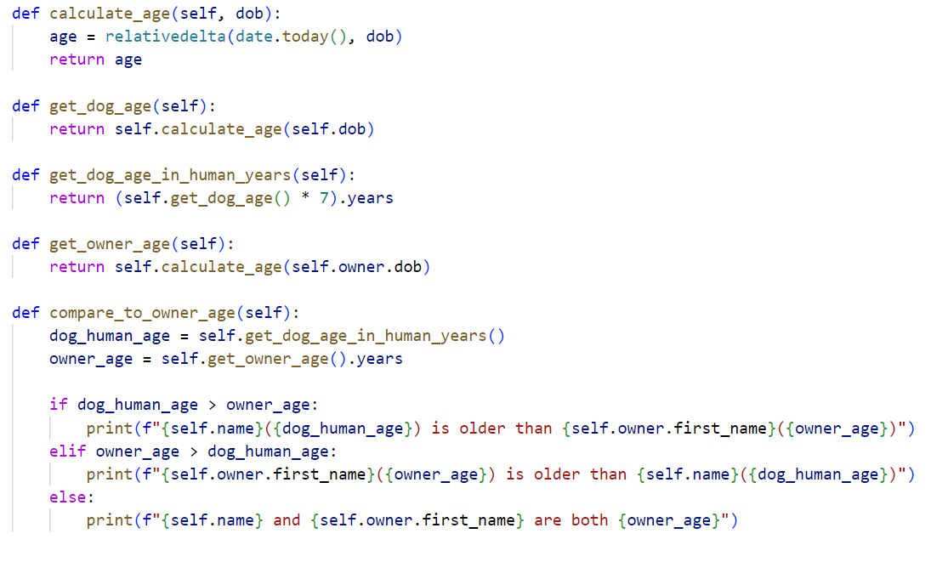
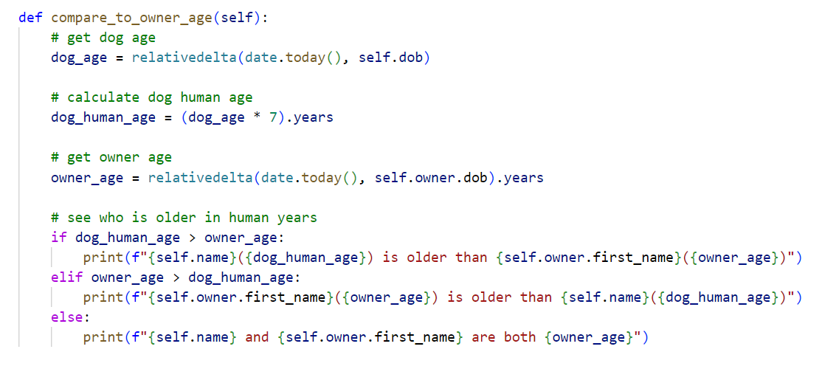
Bloaters
Many parameters
Long methods
Primitive types

Slide 11
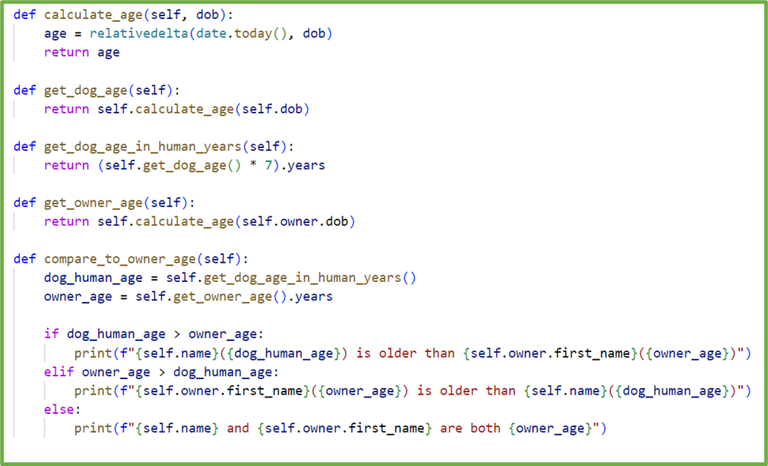
Bloaters
Many parameters
Long methods
Primitive types

Slide 12
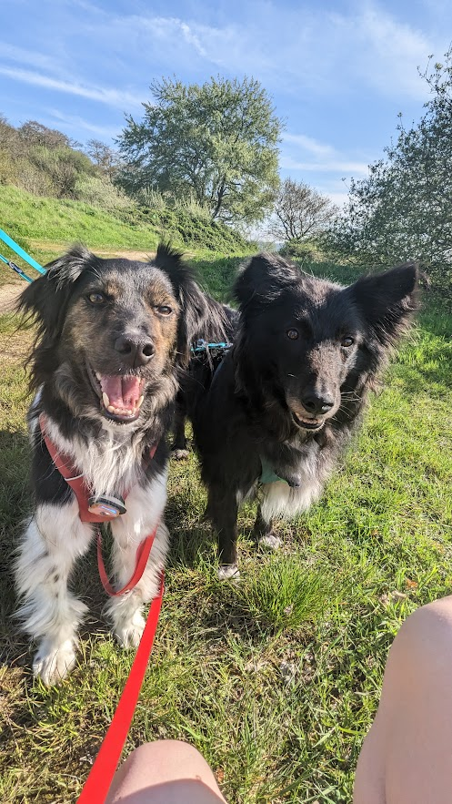
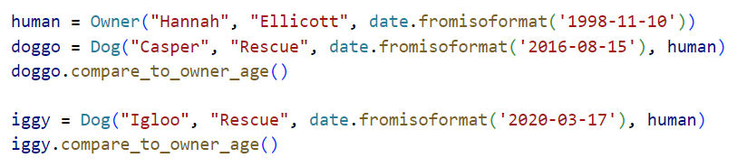
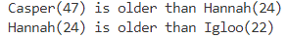

Slide 13
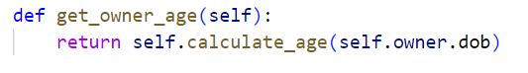
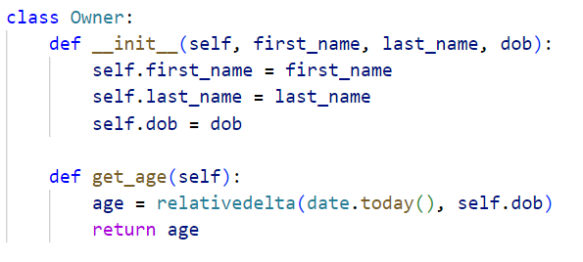
Couplers
Feature envy
Accessing internal fields

Slide 14
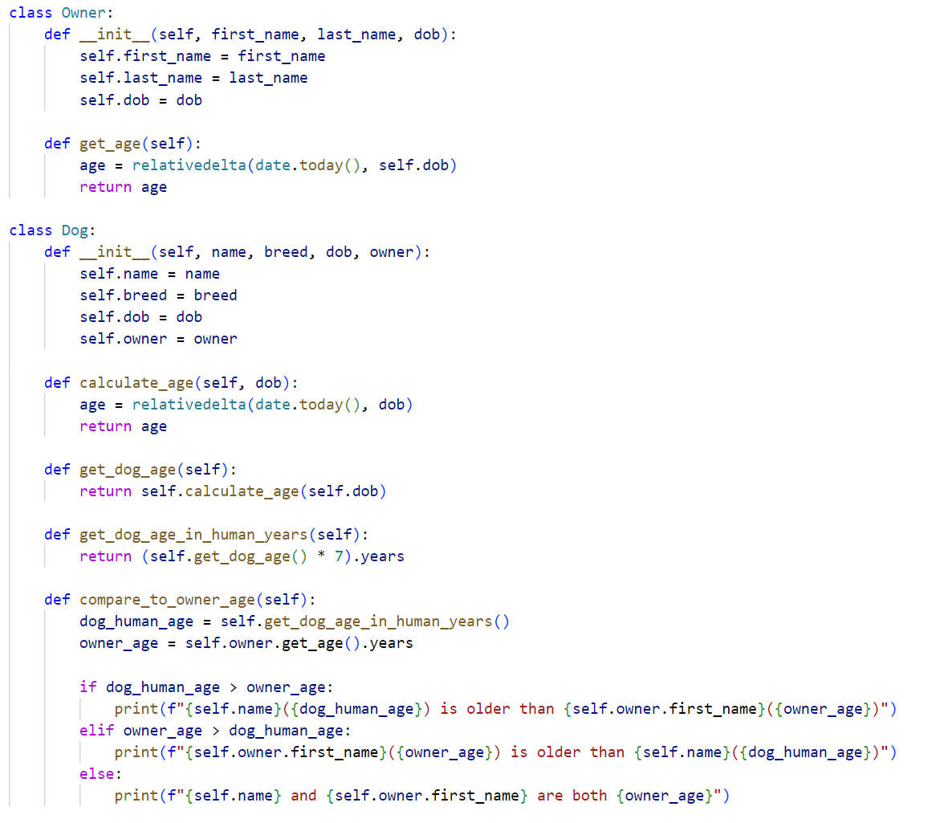

Slide 15
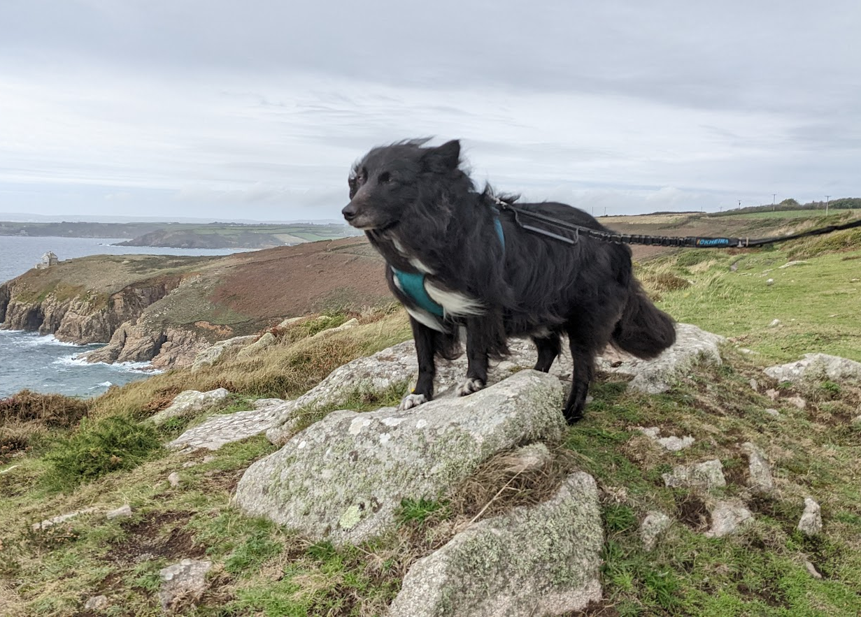
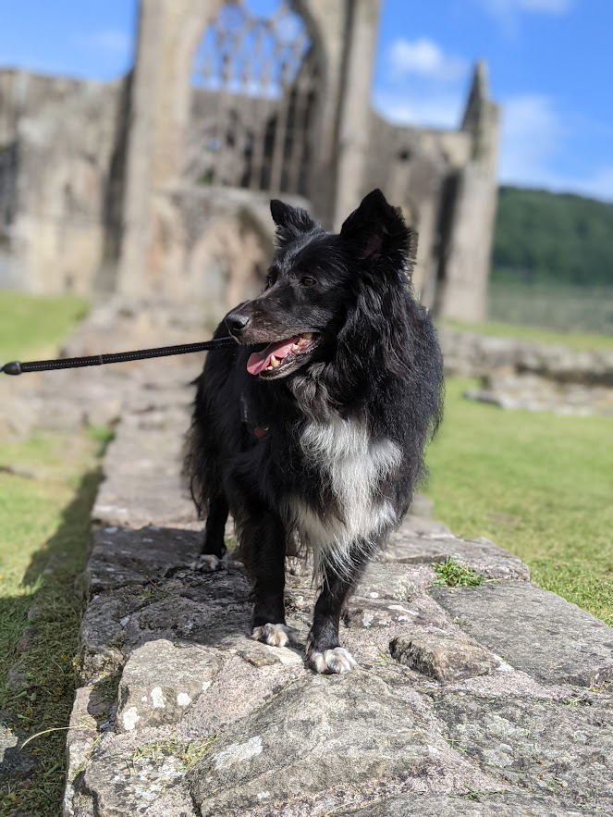
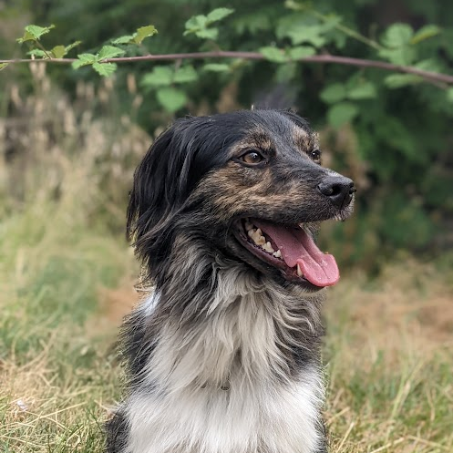
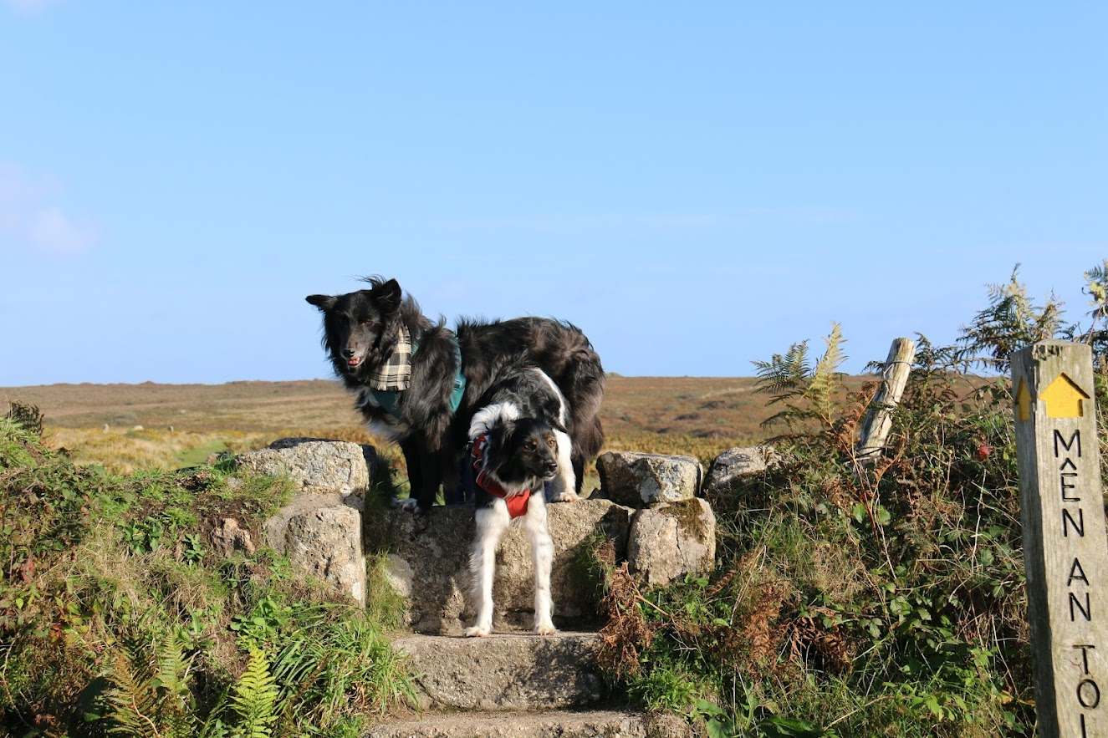
Joy

Slide 16
Recap
How are dogs and programming connected?
Code Smells
Dispensables
Bloaters
Couplers
10 mins
Q&A
5 mins

Slide 17


Thank you!
For more info:
https://refactoring.guru/refactoring/smells
hannah.ellicott@os.uk
https://github.com/hellicott/dog-code-smells

Slide 18
Q+A

